Slide 1

PHD DEFENSE
Movement and Control of
Biomimetic Humanoid Robots
Ben P. Bolen
Mechanical Engineering
November 6, 2026
Portland State University · Agile & Adaptive Robotics Laboratory
1
Notes:
My dissertation makes actuator and transmission assumptions testable, and develops tools for controlled neural–mechanical experiments. Introduce the research robot as the motivating scientific instrument. Advisor: M. Anthony Hunt. Credit the AARL platform and collaborators throughout.
Source: Portland State University · Agile & Adaptive Robotics Laboratory
Figure provenance:
D:\Github\Bipedal_Robot\Documentation\Reports and Papers\Dissertation\Defense\deck_builder\deck_assets\figs\c_mujoco_converted_robot.png

Slide 2
RESEARCH NEED AND KNOWLEDGE GAP
A research robot needs evidence at each model boundary
Unknown in the design | Evidence developed here
Force when actuator length changes | Isometric measurements and force model
Torque through real attachments | Correction identification and route tests
Which sensory findings apply | Searchable, source-linked SADb app
What a coupled circuit actually does | Matched tests and controlled interventions
Dissertation Ch. 1, Motivation and Research Objectives
2
Notes:
Biomimetic robots can test controlled changes that are difficult in living subjects. That use requires evidence linking the chosen actuator, transmission, sensory pathways, and model behavior. These are gaps in this project and workflow. My work addresses each with a distinct test, rather than claiming a completed locomoting humanoid. Steele supplied the four-bar knee; Morrow collaborated on route design; published Li/Deng architectures and existing simulation engines supply essential foundations.
Source: Dissertation Ch. 1, Motivation and Research Objectives
Figure provenance:

Slide 3

BPA FORCE MODEL
Isometric tests isolate force across BPA design choices
537 observations
10 mm and 20 mm BPAs
Length, contraction, and pressure
Force measured at fixed length
Bolen et al. (2026), Actuators 15(5):230 · Dissertation Ch. 3
3
Notes:
A braided pneumatic actuator contracts under pressure. The force study contains 537 force–pressure–contraction observations: 321 for 10 mm and 216 for 20 mm. Tested resting lengths were 112–518 mm and 300–509 mm, respectively, up to 620 kPa. Introduce pressure, resting length, and contraction using the rig. This is static characterization. Credit Elzein, Pang, and Hunt as coauthors.
Source: Bolen et al. (2026), Actuators 15(5):230 · Dissertation Ch. 3
Figure provenance:
D:\Github\Bipedal_Robot\Documentation\Reports and Papers\Dissertation\Defense\deck_builder\deck_assets\figs\testJigs_force.png

Slide 4


RESTING-LENGTH DEPENDENCE
Shorter BPAs deliver less maximum isometric force
Resting length changes the force available to a robot design
Bolen et al. (2026), Actuators 15(5):230 · Dissertation Ch. 3
4
Notes:
At 620 kPa, maximum force decreases at short resting lengths in both diameters. The manufacturer tool predicts the opposite trend. Black points are measured data, solid blue is the fitted model, and dashed magenta is the manufacturer prediction. Resting length therefore must be a model input. Do not generalize beyond the tested actuator families.
Source: Bolen et al. (2026), Actuators 15(5):230 · Dissertation Ch. 3
Figure provenance:
D:\Github\Bipedal_Robot\Documentation\Reports and Papers\Dissertation\Defense\deck_builder\deck_assets\figs\MaxForce10.png
D:\Github\Bipedal_Robot\Documentation\Reports and Papers\Dissertation\Defense\deck_builder\deck_assets\figs\MaxForce20.png

Slide 5

FORCE FORMULATION
Resting-length scaling completes the normalized force model
F* normalized force
P* pressure / 620 kPa
ε* normalized contraction
l₀ resting length
Curves: 200–620 kPa
Solid model; circles measured
Dashed manufacturer
Diameter-specific coefficients remain fixed from the published study
Bolen et al. (2026), Actuators 15(5):230 · Dissertation Ch. 3
5
Notes:
The force is the product of a dimensionless force surface and maximum force at the chosen resting length. Normalized pressure and contraction locate the operating point. Separate coefficients apply to each diameter, and maximum contraction is measured for each actuator. The plotted 20 mm curves show measured points and model isoclines. The source uses an 80/20 point split. This does not establish dynamic performance or every unseen actuator length.
Source: Bolen et al. (2026), Actuators 15(5):230 · Dissertation Ch. 3
Figure provenance:
D:\Github\Bipedal_Robot\Documentation\Reports and Papers\Dissertation\Defense\deck_builder\deck_assets\eqs\force.png
D:\Github\Bipedal_Robot\Documentation\Reports and Papers\Dissertation\Defense\deck_builder\deck_assets\figs\FStar20.png

Slide 6
ONE MEASURED COMPARISON
At 112 mm, the new model reduces force error to 4.5%
10 mm BPA · 112 mm resting length · 620 kPa
Bolen et al. (2026), Actuators 15(5):230 · Dissertation Ch. 3
6
Notes:
This is the 10 mm BPA at 112 mm resting length and 620 kPa. Measured force is 350.9 N, the model gives 335.3 N, and the manufacturer tool gives 498.6 N. Reported errors are 4.5% and 42.1%. This is one reported case, not the average error or an independent length holdout. The native chart uses the published values directly.
Source: Bolen et al. (2026), Actuators 15(5):230 · Dissertation Ch. 3
Figure provenance:

Slide 7
TORQUE GEOMETRY
Joint torque depends on force direction and moment arm
p
F
τz = (r × F) · ẑ
r⊥
r
|τz| = F r⊥
O
Routing also changes
actuator length
A force model needs a transmission model to predict delivered torque
Dissertation Ch. 4 · Current knee-torque manuscript, §§3–4
7
Notes:
Use the editable schematic to explain the cross product. The joint is O, the attachment is p, and the tensile force acts along its route. The perpendicular distance to the force line is the moment arm. Torque magnitude is force times that distance. Routing changes both moment arm and actuator excursion, so maximizing moment arm alone can reduce usable force. The diagram is conceptual and has no numerical geometry.
Source: Dissertation Ch. 4 · Current knee-torque manuscript, §§3–4
Figure provenance:

Slide 8
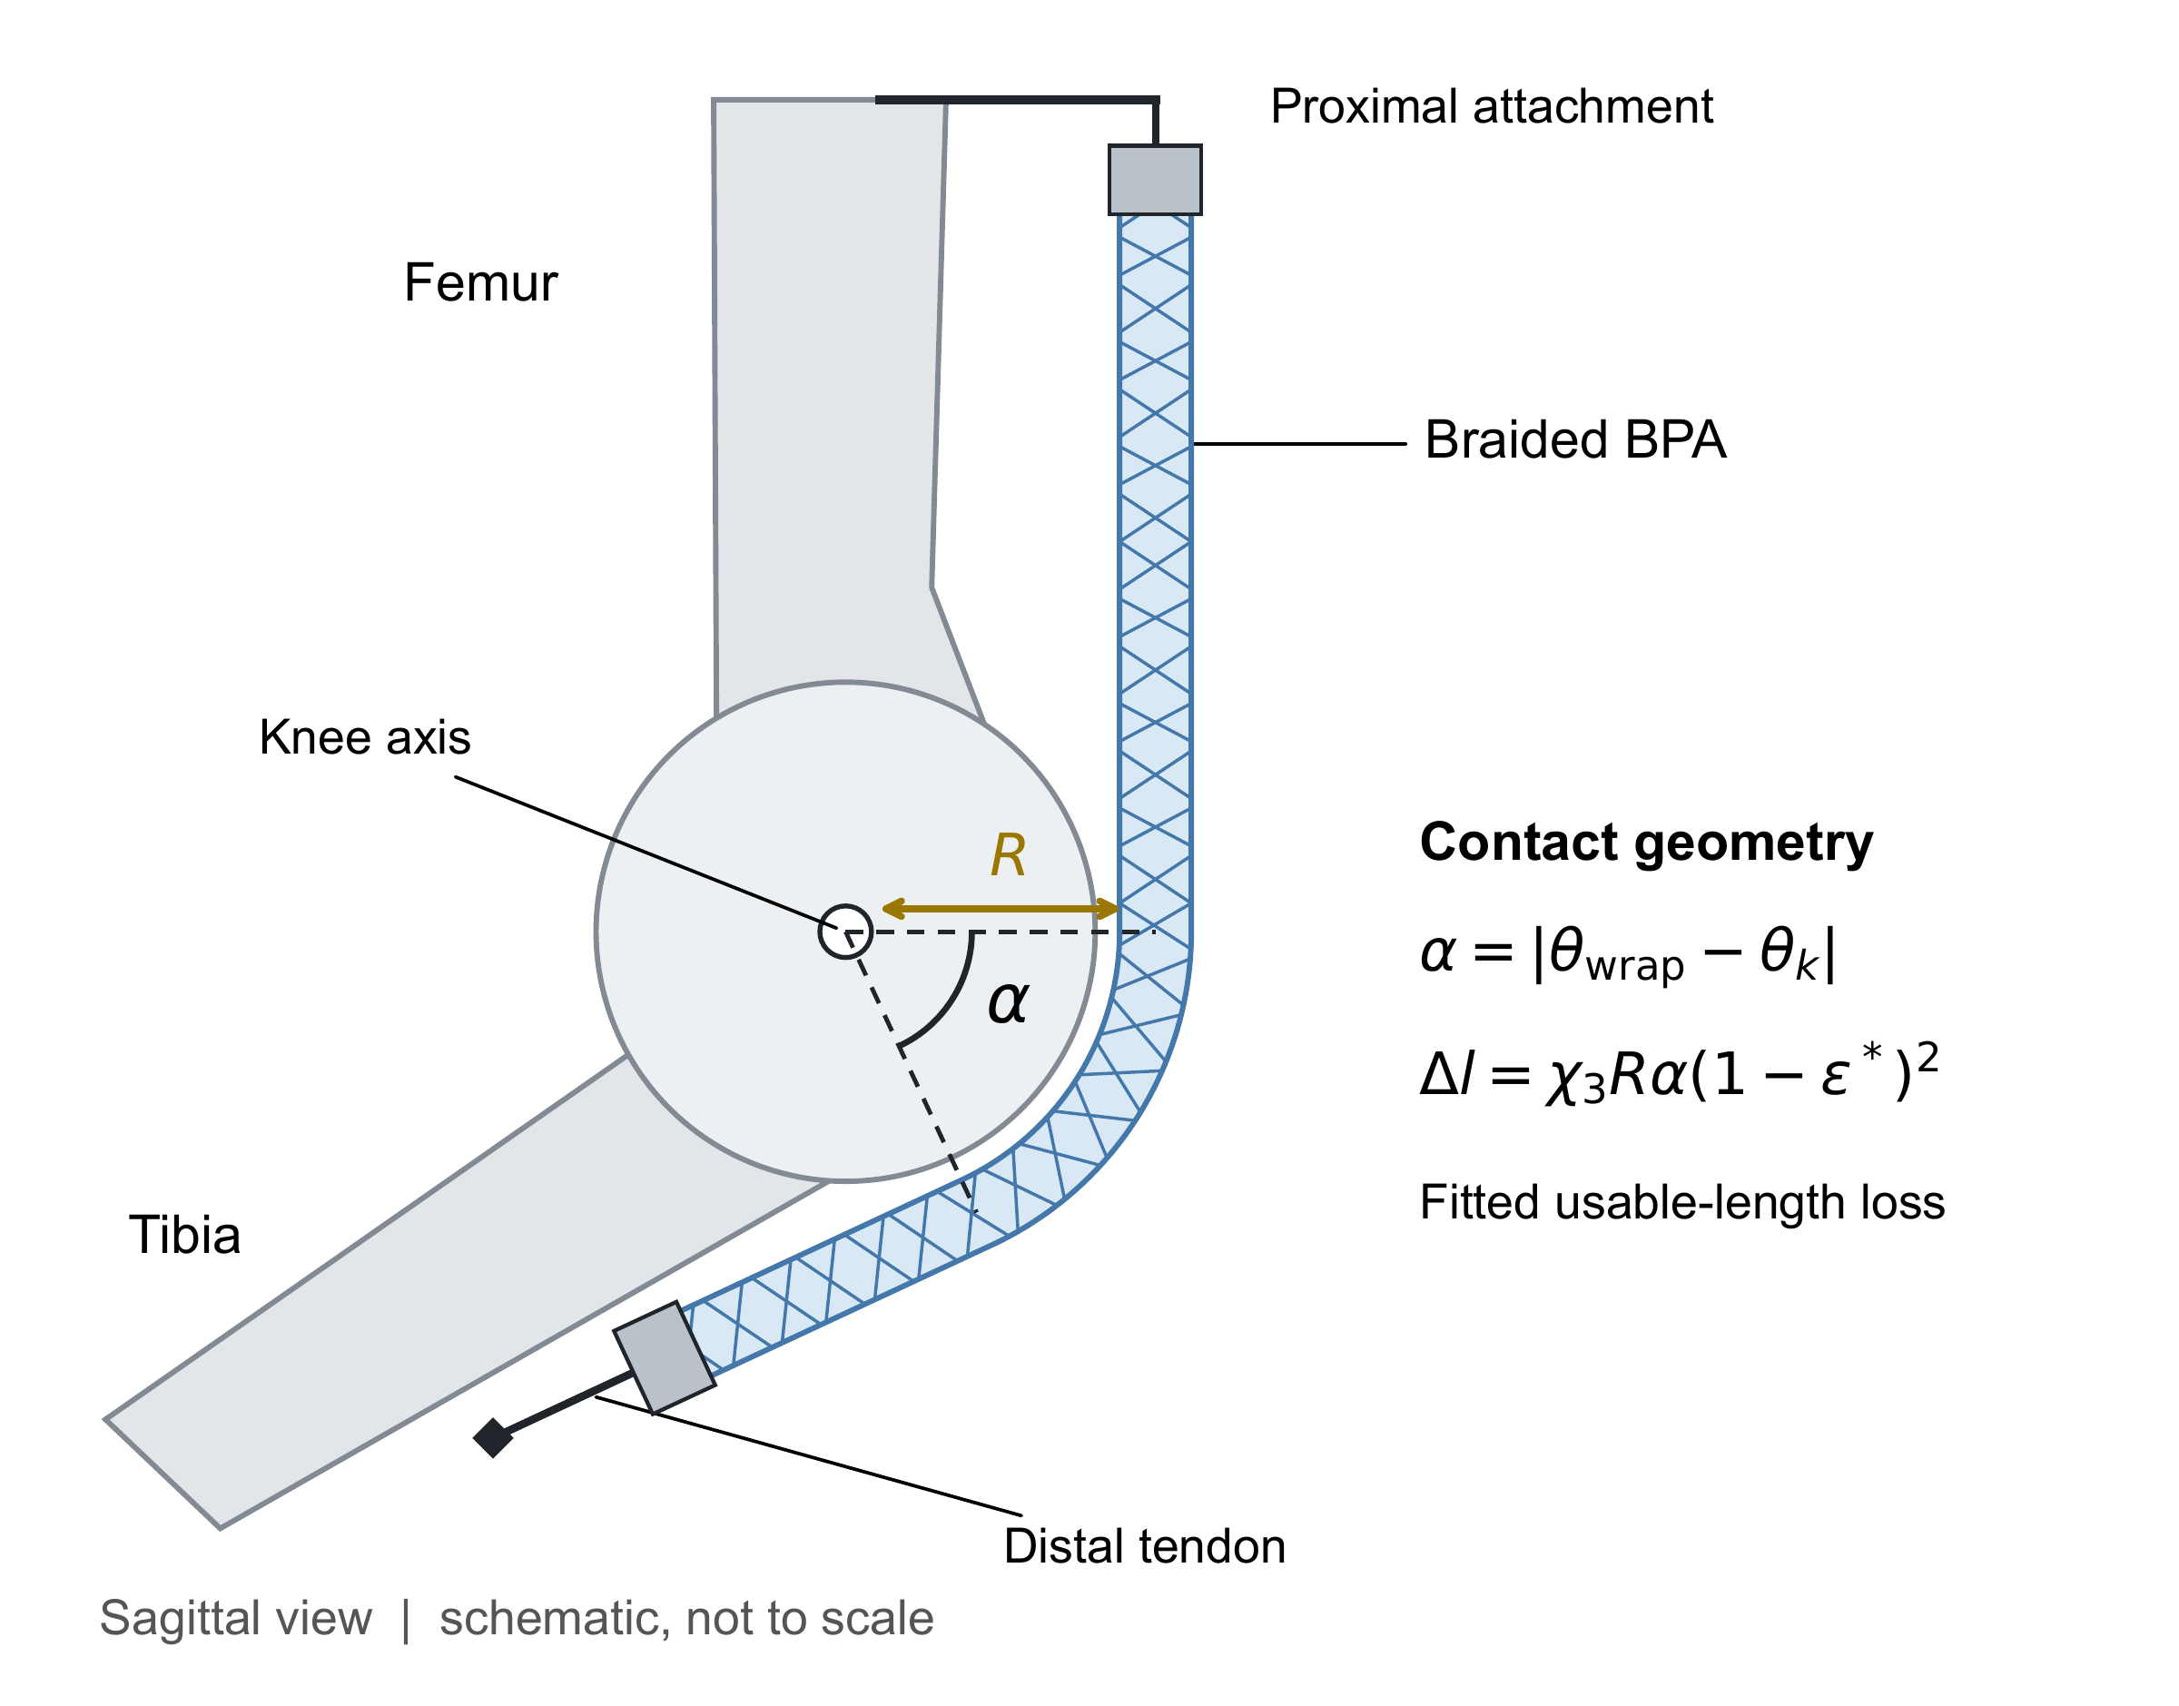

TRANSMISSION CORRECTIONS
Length, compliance, and wrapping alter usable contraction
Constant offset
Load-dependent deflection
Contact-dependent length loss
The correction terms belong to the actuator–attachment system
Dissertation Ch. 4 · Current knee-torque manuscript, §§3–4
8
Notes:
The model includes a constant length offset, force-dependent displacement in effective attachment frames, and an empirical wrapping loss. χ1 and χ2 describe effective system stiffness, including fixtures and the winch, rather than isolated bracket material stiffness. One pair is shared across flexor and extensor. The wrapping schematic explains contact angle and length loss. Identification uses existing measured tests; route optimization then uses the adopted terms unchanged.
Source: Dissertation Ch. 4 · Current knee-torque manuscript, §§3–4
Figure provenance:
D:\GitHub\Bipedal_Robot\Documentation\Reports and Papers\Dissertation\Figures\30-torque\bpa_knee_wrapping_review.pdf
D:\Github\Bipedal_Robot\Documentation\Reports and Papers\Dissertation\Defense\deck_builder\deck_assets\figs\b_bktframe_pin.png

Slide 9
IDENTIFICATION EVIDENCE
Corrections reduce error on held-out knee tests
Validation RMSE, N m | No corrections | Corrected
Flexor, 2 tests | 7.588 | 1.490
Extensor, 3 tests | 2.554 | 1.098
Same stiffness pair across both configurations
Tests reserved before evaluating the adopted fit
Dissertation Ch. 4 · Current knee-torque manuscript, §§3–4
9
Notes:
These exact validation means compare the characterized BPA model with all correction terms disabled against the adopted corrected model. Flexor uses two held-out tests, and extensor three. They are the selected folds of the existing identification, not newly collected tests. The same stiffness pair applies to both. One extensor training test retains FVU above one. The claim is lower held-out error, not uniformly accurate fits.
Source: Dissertation Ch. 4 · Current knee-torque manuscript, §§3–4
Figure provenance:

Slide 10

ROUTE OPTIMIZATION AND HARDWARE
The corrected model guides a buildable two-BPA cam route
Two 20 mm BPAs
Cam-assisted tendon path
Adopted transmission
corrections guide the design
The route must satisfy force, excursion, and geometric constraints
Dissertation Ch. 4 · Current knee-torque manuscript, §§3–4
10
Notes:
The extensor redesign uses two 20 mm BPAs. The photo shows the assembled cam-assisted route. The optimizer varies geometry under packaging and torque constraints, using the adopted corrections. Credit Morrow for route-design collaboration and Steele for the underlying four-bar knee. Correction identification and route redesign answer different questions.
Source: Dissertation Ch. 4 · Current knee-torque manuscript, §§3–4
Figure provenance:
D:\Github\Bipedal_Robot\Documentation\Reports and Papers\Dissertation\Notes\advisor_revision_20261022\Revision_C\figs\30-torque\cam_extensor_hardware.jpg

Slide 11

PREDICTED DESIGN CAPACITY
The cam model predicts headroom above the required target
+30.83% above required envelope · 269–507 kPa predicted pressure
Dissertation Ch. 4 · Current knee-torque manuscript, §§3–4
11
Notes:
The adopted cam design predicts a minimum margin of 30.83% over the required envelope, which itself includes 5% overshoot above the selected human reference. The minimum margin over the plain human target is 39.77%. Predicted pressure needed for the required envelope is 269–507 kPa. The blue curve is the 620 kPa model prediction. These margins are predictions, not physical measurement margins.
Source: Dissertation Ch. 4 · Current knee-torque manuscript, §§3–4
Figure provenance:
D:\Github\Bipedal_Robot\Documentation\Reports and Papers\Dissertation\Notes\advisor_revision_20261022\Revision_C\figs\30-torque\Vas_Pam_20mm_cam_winner_1_r2.png

Slide 12
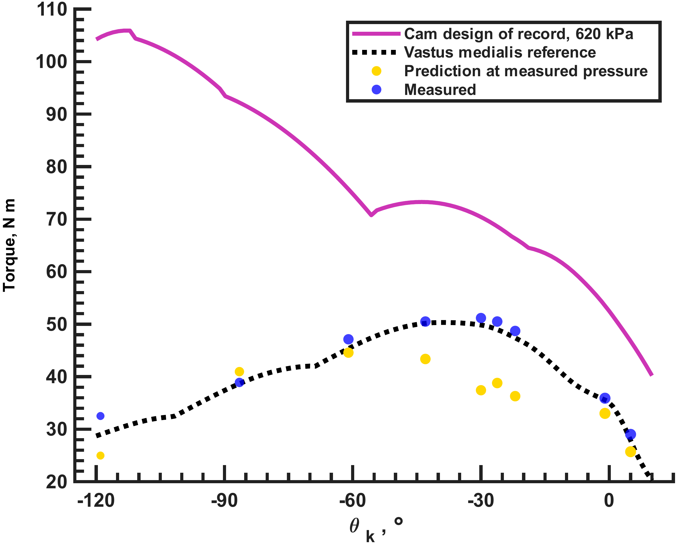
PHYSICAL EXTENSOR CAPACITY
All nine extensor measurements meet the human target
9 of 9 target margins positive · +0.24 to +3.52 N m
Dissertation Ch. 4 · Current knee-torque manuscript, §§3–4
12
Notes:
Read the series identities: blue points are measured, yellow points are predictions at the measured pressures, the dotted black curve is vastus medialis, and magenta is the optimized 620 kPa prediction. All nine measurements exceed the selected human target, including −86.5 degrees. At that angle, the measured torque is 2.06 N m below the pressure-specific prediction. Measured torque is 29.02–51.17 N m; target margins are +0.24 to +3.52 N m at 256–488 kPa. Discrete holds span −119 to +5 degrees. They establish capacity at those configurations.
Source: Dissertation Ch. 4 · Current knee-torque manuscript, §§3–4
Figure provenance:
D:\GitHub\Bipedal_Robot\Documentation\Reports and Papers\Dissertation\Figures\30-torque\Ext20mm_physical_20261026_publication.pdf

Slide 13
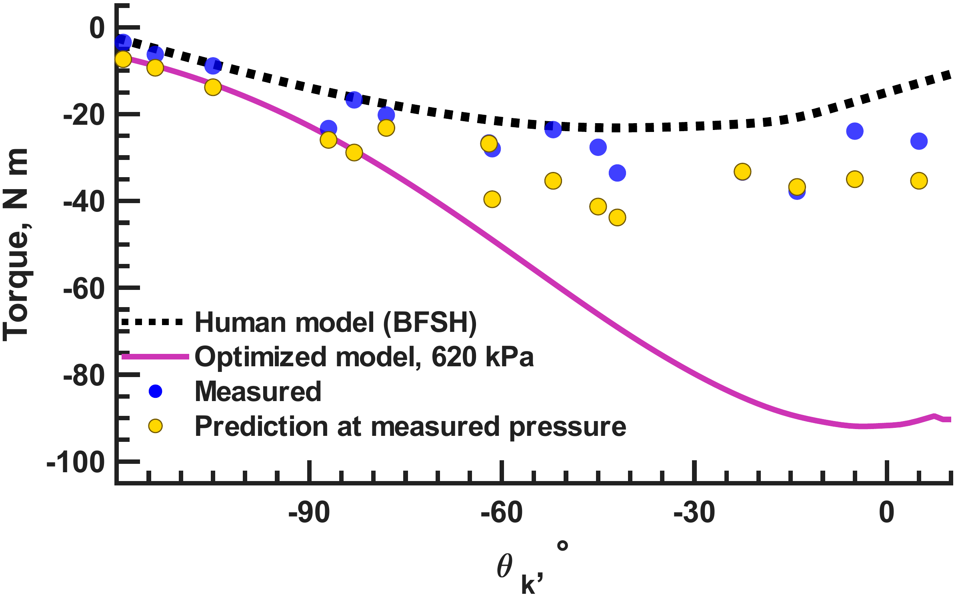
PHYSICAL FLEXOR CAPACITY
All fifteen flexor measurements meet the human target
15 of 15 targets met · 226.5–638 kPa · negative torque denotes flexion
Dissertation Ch. 4 · Current knee-torque manuscript, §§3–4
13
Notes:
The selected human target is maximum-isometric biceps femoris short head from OpenSim Gait2392. Flexion torque is negative, so compare magnitudes. All 15 holds meet or exceed it from −119 to +5 degrees. The source reduction gives margins +0.42 N m at −105 degrees to +17.0 N m at −14 degrees. Recorded pressures are 226.5–638 kPa. Physical lengths are 561/28 and 560/30 mm resting/tendon. Preserve the nominal 562 mm prediction label and distinguish prediction settings from these measurements. The full-pressure predicted curve and variable-pressure points are different conditions. Capacity is demonstrated while prediction agreement remains uneven.
Source: Dissertation Ch. 4 · Current knee-torque manuscript, §§3–4
Figure provenance:
D:\GitHub\Bipedal_Robot\Documentation\Reports and Papers\Dissertation\Figures\30-torque\Redesigned_flexor_pressure_publication.pdf

Slide 14
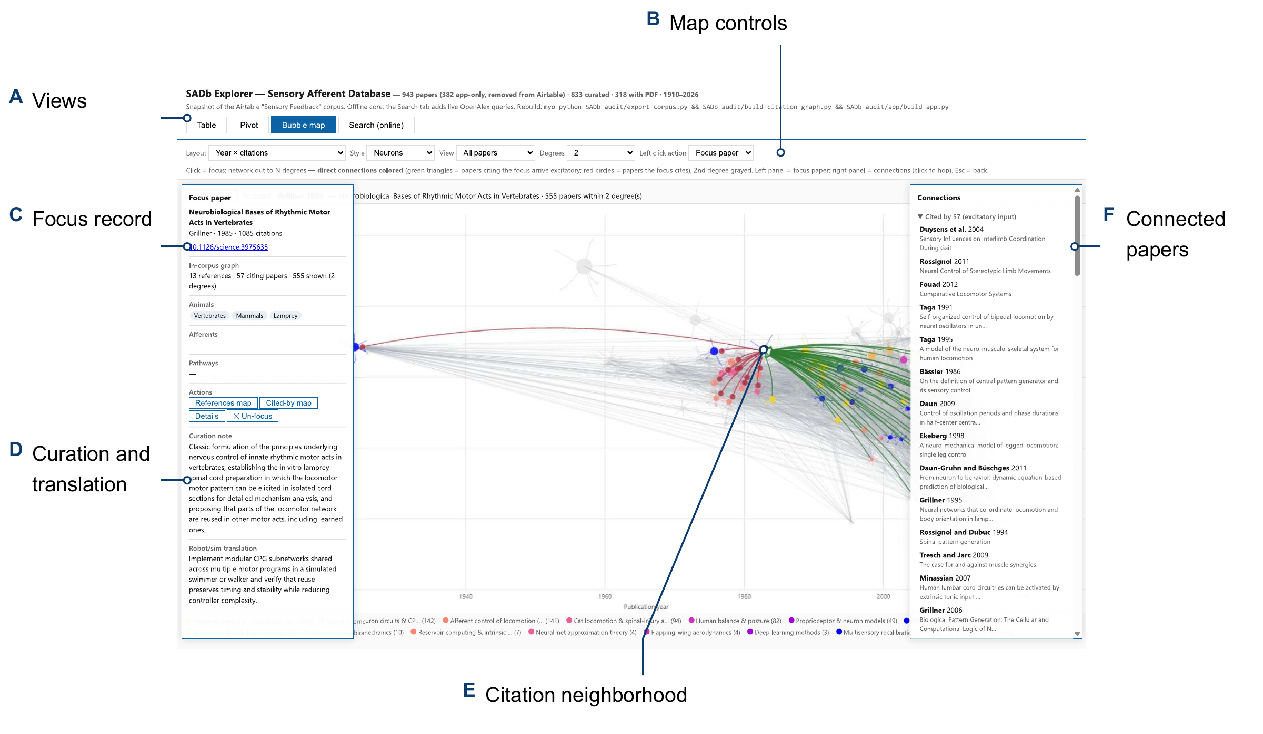
SENSORY AFFERENT DATABASE
SADb makes sensory evidence traceable to its source context
1,393 total records · search, pivot, and follow citation links
Dissertation Ch. 5, The Resource · Appendix E, distributed app snapshot
14
Notes:
Use the six annotated callouts to explain the app: A view selection, B map controls, C focus record, D curation and translation, E citation neighborhood, and F connected papers. Search and filter across 1,393 total app records, including 943 in the Papers category. Models and reviews can also be publications, so the category count is not a total publication count. Table search spans record types; pivots and citation views use paper records. Embedded data support offline exploration; the online-search tab requires a network. A static screenshot shows functionality, not retrieval accuracy.
Source: Dissertation Ch. 5, The Resource · Appendix E, distributed app snapshot
Figure provenance:
D:\GitHub\Bipedal_Robot\Documentation\Reports and Papers\Dissertation\Figures\50-database\sadb_bubble.pdf

Slide 15
NEUROMECHANICAL KNOWLEDGE GAP
Controlled interventions turn a coupled model into an experiment
Specify the circuit
Check matched inputs
Change one condition
Source, sign, and signal
Neural and interface
agreement
Feedback, stimulation,
or mechanical support
The demonstrations test implementation, sensory contribution,
and mechanical response separately
Dissertation Ch. 6 and Appendix D · Current saved verification records
15
Notes:
The gap is interpreting the behavior of a particular neural–mechanical combination. My contributions include graphical SNS blocks, actuator and model coupling, model audits, and controlled evaluation procedures. Existing engines and published neural formulations supply essential foundations. The experiment sequence asks whether a circuit is implemented as specified, whether an intervention changes behavior, and whether that response agrees with a mechanical reference. SADb supports choosing the pathway and preserving its source conditions; it does not supply ready-made gains.
Source: Dissertation Ch. 6 and Appendix D · Current saved verification records
Figure provenance:

Slide 16

IMPLEMENTATION AGREEMENT
Matched rhythm cores reproduce the same driven bursts
1.000 s period · 10 expected bursts · correlation ≥ 0.99996
Dissertation Ch. 6 and Appendix D · Current saved verification records
16
Notes:
This comparison uses the driven W2L rhythm core, with matched connectivity, initial states, and phasic heel-contact input. Periods match at 1.000 s, all ten expected bursts occur, and trace correlation is at least 0.99996. A 2 ms lag equals one solver step. Removing the specified phasic inputs latches both implementations. This is agreement under a defined protocol, not full-network equivalence. The bridge additionally gives bit-exact scored sensor readback, but a separate tonic-drive full circuit settles in Simulink while its NumPy reference oscillates.
Source: Dissertation Ch. 6 and Appendix D · Current saved verification records
Figure provenance:
D:\GitHub\Bipedal_Robot\Documentation\Reports and Papers\Dissertation\Figures\60-sns\sns_w2l_traces.png

Slide 17
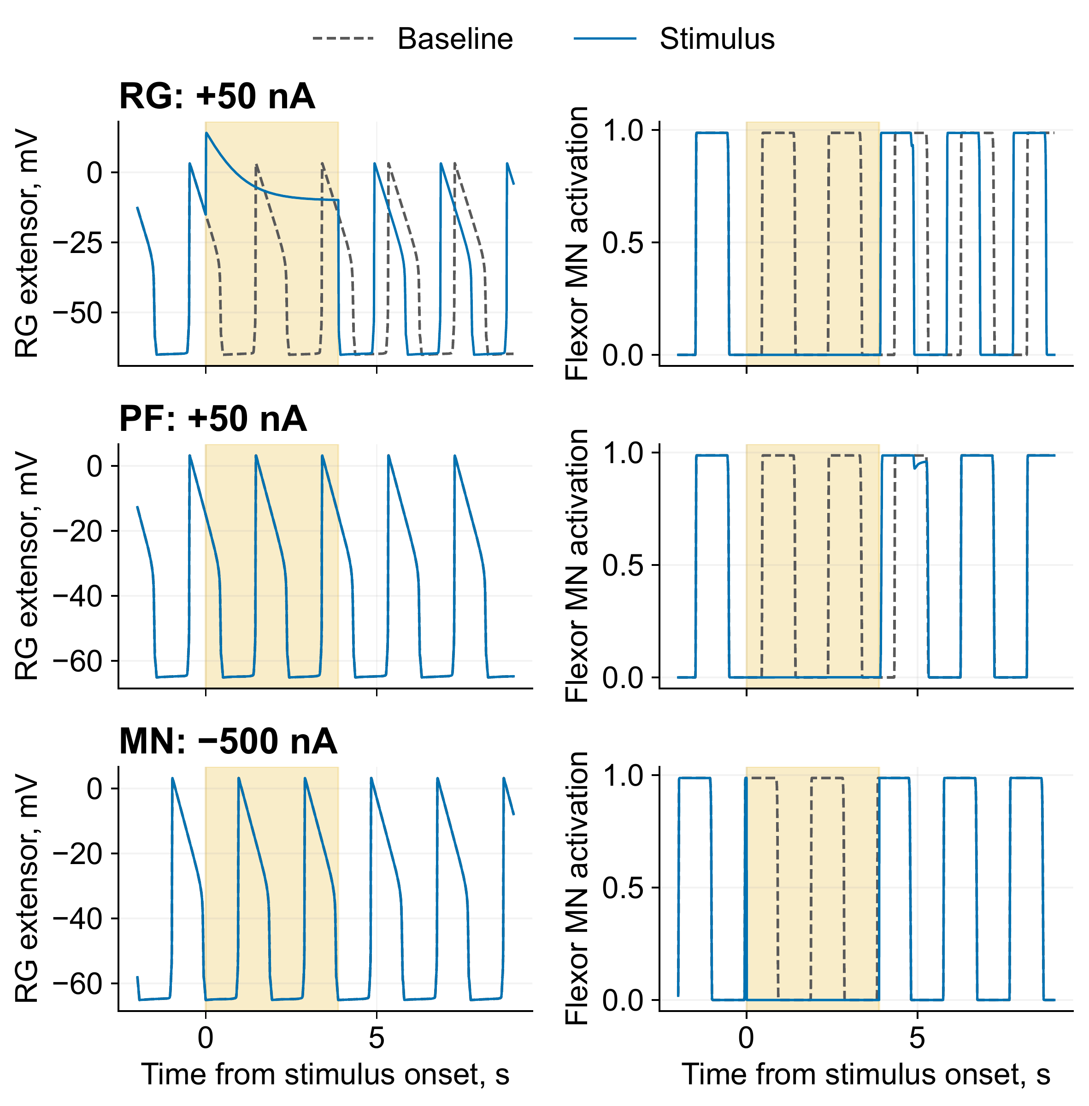
LAYER-SPECIFIC STIMULATION
Two deleted bursts can preserve or reset the rhythm
Stimulated layer | RG shift, cycles
RG | 0.211
PF | 0.000
MN | 0.000
RG: rhythm generator
PF: pattern formation
MN: motor neuron
Reduced Deng-derived circuit · two baseline periods · suspended model
Dissertation Ch. 6 and Appendix D · Current saved verification records
17
Notes:
The reduced Deng-derived translated circuit is coupled to a suspended model. Stimuli lasting two baseline periods suppress two expected flexor motor bursts at each tested layer. RG-extensor +50 nA shifts both RG and motor timing by 0.211 cycle. PF-extensor +50 nA suppresses output without resetting the RG clock, and flexor-MN −500 nA also gives a non-resetting deletion. Read left RG traces and right MN activation together. Stronger-current controls matter: a one-second PF pulse shifts motor timing by 0.208 cycle while RG timing stays unchanged. A motor shift alone therefore does not prove RG resetting. This is a translated reduced-circuit test, not original-rat locomotion replication.
Source: Dissertation Ch. 6 and Appendix D · Current saved verification records
Figure provenance:
D:\GitHub\Bipedal_Robot\Documentation\Reports and Papers\Dissertation\Figures\95-AppendixD\layer_stimulus_validation.pdf

Slide 18
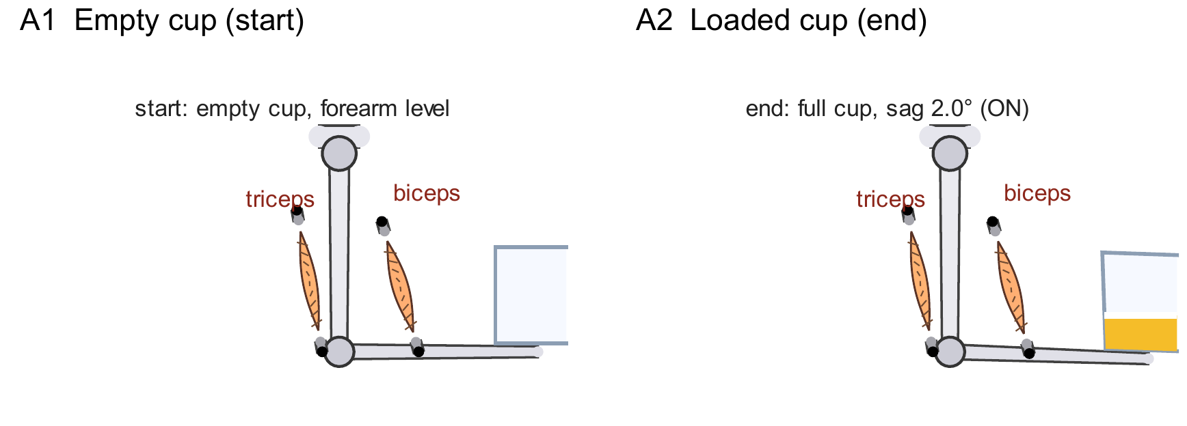
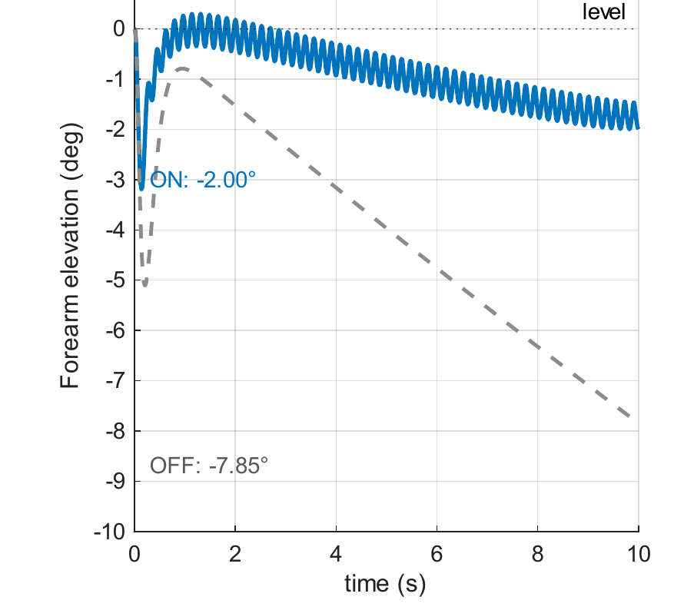
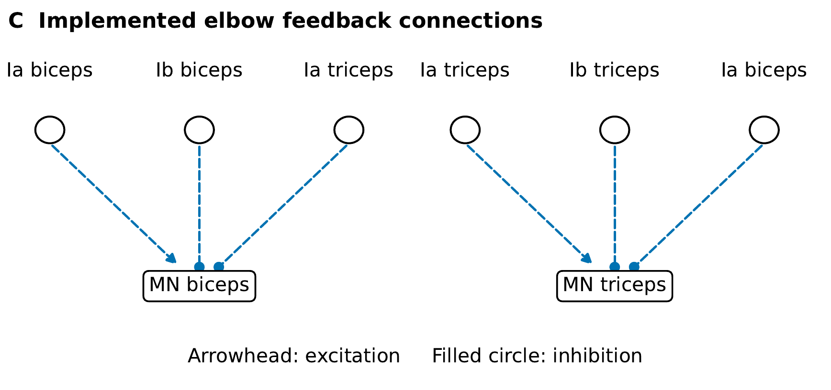
CORRECTIVE FEEDBACK DEMONSTRATION
Sensory feedback reduces sag in the loaded-arm model
B Feedback on/off
Sag: 2.00° with feedback · 7.85° without feedback
Dissertation Ch. 6 and Appendix D · Current saved verification records
18
Notes:
A1 and A2 show the empty and loaded container. B compares forearm elevation with feedback on and off. Sag is 2.00 degrees with feedback versus 7.85 degrees without. C shows the actual implemented circuit: biceps Ia excites biceps MN and inhibits triceps MN; triceps Ia does the converse. Own-muscle Ib inhibits its MN. Arrowheads mean excitation, and filled circles inhibition. This demonstrates a corrective effect in the reduced block model under the selected settings.
Source: Dissertation Ch. 6 and Appendix D · Current saved verification records
Figure provenance:
D:\GitHub\Bipedal_Robot\Documentation\Reports and Papers\Dissertation\Figures\60-sns\beverage_current_layout.pdf
D:\GitHub\Bipedal_Robot\Documentation\Reports and Papers\Dissertation\Figures\60-sns\beverage_current_layout.pdf
D:\GitHub\Bipedal_Robot\Documentation\Reports and Papers\Dissertation\Figures\60-sns\beverage_current_layout.pdf

Slide 19
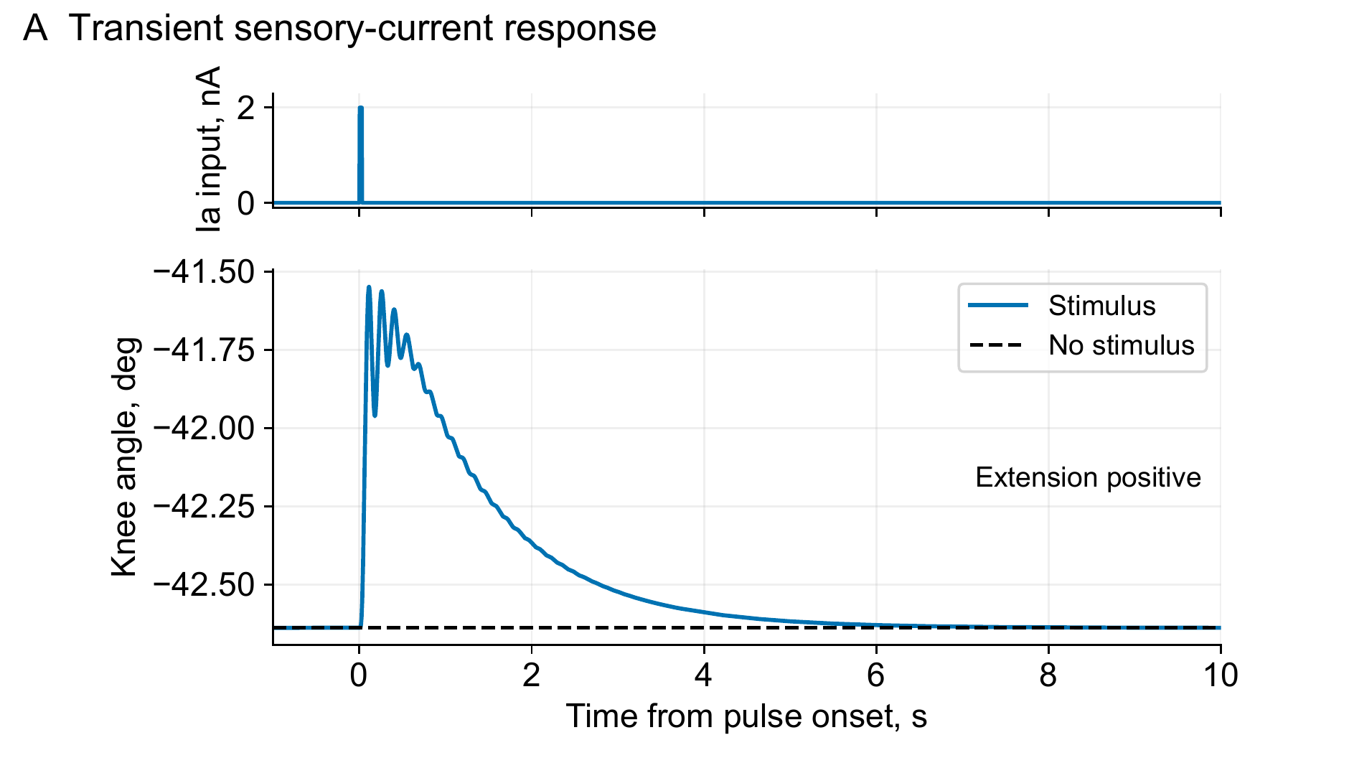
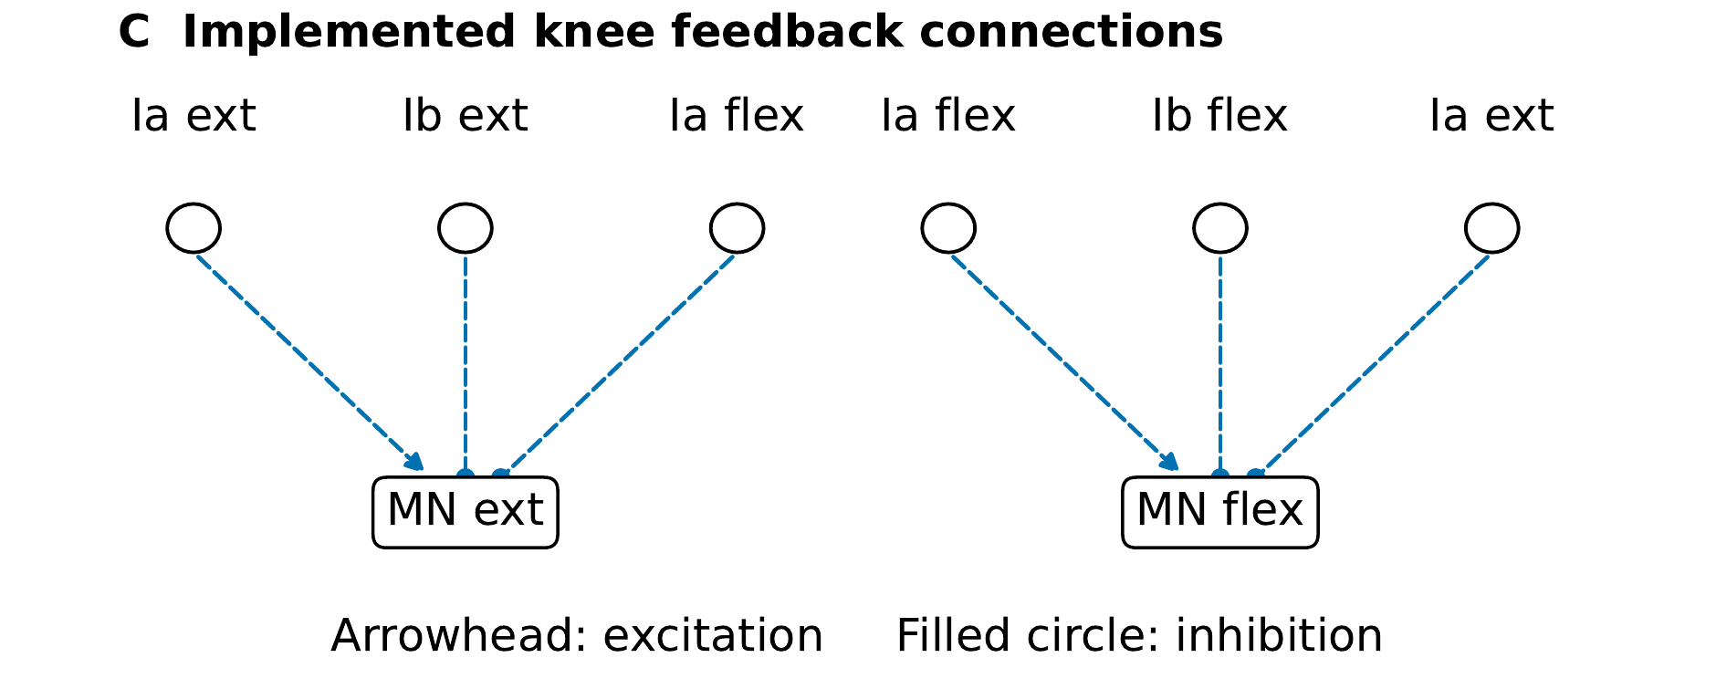
TRANSIENT ENGINEERING DEMONSTRATION
The knee model produces a transient sensory response
2 nA for 30 ms
1.09° at 111 ms
Recovery at 6.355 s
Six neural saturation widths changed in this configuration
Dissertation Ch. 6 and Appendix D · Current saved verification records
19
Notes:
A matched no-stimulus run isolates the effect of a 2 nA, 30 ms current pulse at the extensor Ia input after settling. The peak extension excursion is 1.09 degrees at 111 ms, and the stated recovery thresholds are met at 6.355 s. Six MN/Ia synaptic saturation widths were broadened; the original narrow ramps sustained oscillations. C shows the six feedback connections. These are engineered block settings, not a calibrated human tendon-tap reflex.
Source: Dissertation Ch. 6 and Appendix D · Current saved verification records
Figure provenance:
D:\GitHub\Bipedal_Robot\Documentation\Reports and Papers\Dissertation\Figures\60-sns\knee_transient_current_layout.pdf
D:\GitHub\Bipedal_Robot\Documentation\Reports and Papers\Dissertation\Figures\60-sns\knee_transient_current_layout.pdf

Slide 20
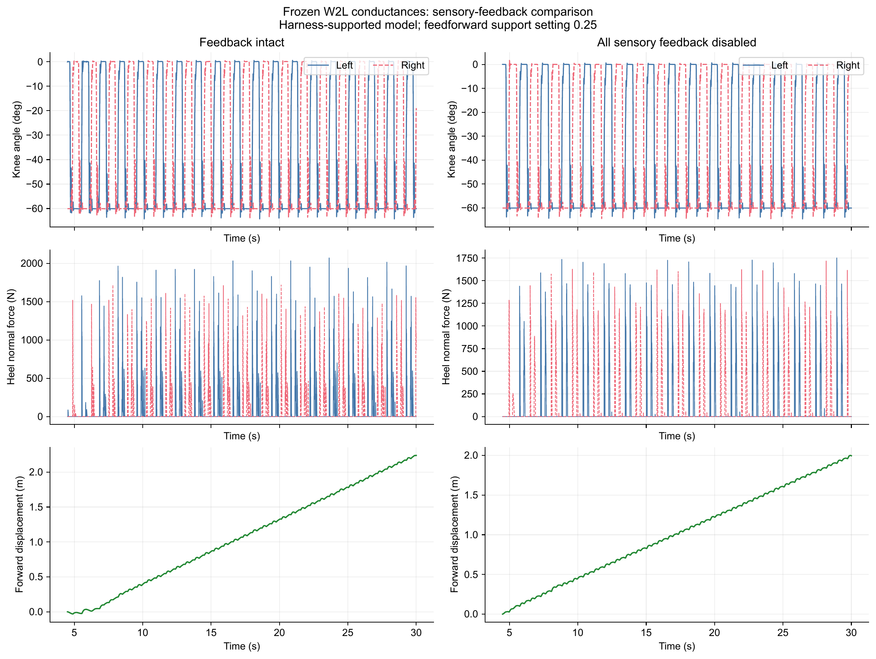
FIXED-CONTROLLER INTERVENTION
Feedback coordinates foot loading in the W2L model
Median bilateral contact phase: 0.498 intact · 0.223 without feedback
Dissertation Ch. 6 and Appendix D · Current saved verification records
20
Notes:
This recovered W2L comparison fixes effective conductances, drive, and support settings, then disables all sensory feedback. Median contact phase changes from 0.498 to 0.223 cycles. The accepted supported-stepping interval is 0.35–0.65, with 0.5 indicating alternation. Forward motion and joint cycling persist after deletion. Over 4.5–30 s, displacement is 2.239 m with feedback and 1.996 m without. The demonstrated contribution is contact coordination. Do not confuse this paired protocol with the separately supported basin/replay tests.
Source: Dissertation Ch. 6 and Appendix D · Current saved verification records
Figure provenance:
D:\GitHub\Bipedal_Robot\Documentation\Reports and Papers\Dissertation\Figures\60-sns\w2l_feedback_verified.pdf

Slide 21
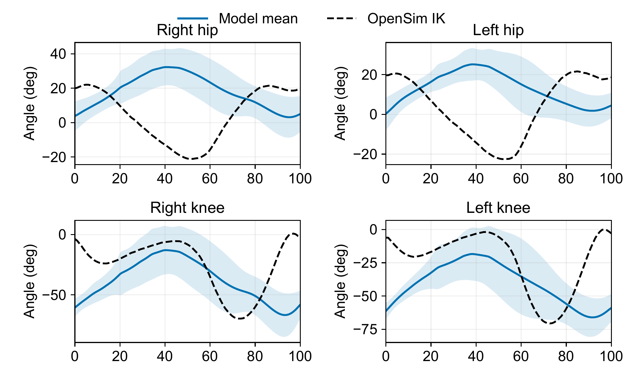
COMPARISON AGAINST A MOVEMENT REFERENCE
Rhythmic Gait2392 cycles retain hip and knee errors
Hip timing differs
Knee timing differs
No fitted phase shift
or amplitude scaling
Gait cycle, %
10 cycles per leg · stance fractions 0.71 / 0.65 versus reference 0.61
Dissertation Ch. 6 and Appendix D · Current saved verification records
21
Notes:
The supported human-model replay contains ten detected cycles per leg. This crop shows hip and knee mean and one standard deviation against the Gait2392 inverse-kinematics reference. Each leg aligns to its own loading onset with no fitted phase shift, angle offset, or amplitude adjustment. Hip and knee timing differences remain visible. Model stance fractions are 0.71 right and 0.65 left versus reference 0.61. Separate leg alignment does not prove bilateral coordination. The complete ankle/contact overlay is backup slide 34. Rhythmic cycles alone do not establish normal human gait.
Source: Dissertation Ch. 6 and Appendix D · Current saved verification records
Figure provenance:
D:\GitHub\Bipedal_Robot\Documentation\Reports and Papers\Dissertation\Figures\60-sns\gait2392_ik_overlay.pdf

Slide 22

CAD-MODEL INTEGRATION
Extra abductor control prevents crossing in the AH001 test
15–40 s | Off | On
Crossed states | 67% | 0%
Min. spacing | −38.3 mm | 142.4 mm
54 reference-tension actuators · 262 neurons / 230 inputs
Dissertation Ch. 6 and Appendix D · Current saved verification records
22
Notes:
Anterior and oblique views show the same saved state. Matched 15–40 s runs compare the separation-control bundle off and on. Reversed ankle ordering changes from 67% to zero, and minimum separation from −38.3 to 142.4 mm. The bundle adds separation feedback and raises the currently abducting-route activation floor from 5% to 6%. The current model has 54 reference-tension actuators and 262 neurons/230 inputs. The hybrid MN clamp cancels incoming PF/reflex currents, so it does not establish effective PF/reflex control of activation. Regular stepping is not accepted. Use the GIF as an optional replay, with support and geometry assumptions on the next slide.
Source: Dissertation Ch. 6 and Appendix D · Current saved verification records
Figure provenance:
D:\GitHub\Bipedal_Robot\Documentation\Reports and Papers\Dissertation\Defense\slideshow\AH001_20261028\ah001_abductor_control_still.png

Slide 23
SCOPE OF THE DEMONSTRATIONS
The evidence establishes specific capabilities within clear limits
Evidence level | What the result establishes | Remaining boundary
Measured hardware | Isometric torque capacity | Dynamic response and transfer
Neural demonstrations | Specified response and intervention effect | Circuit- and protocol-specific
Supported W2L / human models | Coupling and coordination tests | External support remains
AH001 integration | Hybrid allocation; PF/reflex currents cancelled | 80% vertical + lateral/angular support
AH001: reference tensions, MN clamp, provisional feet, and ideal brackets
No harness-free walking has been demonstrated
Current manuscript Ch. 6 / Appendix D · Session 1 AH001 records
23
Notes:
Concentrate model scope here. W2L and human-model evaluations retain mechanical support. No harness-free walking is established anywhere in the program. For AH001 the displayed interval uses 80% actual vertical assistance plus lateral and angular support. Actuators are reference tensions, not calibrated BPA dynamics. The MN clamp cancels incoming PF and reflex currents. Foot mounting is provisional, with ideal rigid attachment brackets and assumed passive knee stops. Preventing crossing does not establish regular stepping, balance, or hardware validity. Keep these distinctions without repeating the limitation on every slide.
Source: Current manuscript Ch. 6 / Appendix D · Session 1 AH001 records
Figure provenance:

Slide 24
SYNTHESIS OF CONTRIBUTIONS
Each contribution closes a different part of the original gap
Contribution | Decisive evidence
Resting-length-aware BPA model | Measured force across length, pressure, and contraction
Corrected knee model and routes | Lower held-out error; 24 of 24 physical targets met
Sensory evidence application | 1,393 searchable, linked app records
Neuromechanical experiment tools | Matched circuits, feedback interventions, and IK overlays
Dissertation Chs. 1, 3–7 · Current physical and simulation evidence
24
Notes:
Return explicitly to the knowledge gap. Force characterization supports actuator selection at different resting lengths. Joint corrections and physical tests connect that force to delivered knee torque. SADb makes physiological findings inspectable in their source contexts. Controlled model interventions separate implementation agreement, feedback effects, and mechanical mismatch. These are complementary evidence chains. They do not yet constitute an integrated autonomous humanoid.
Source: Dissertation Chs. 1, 3–7 · Current physical and simulation evidence
Figure provenance:

Slide 25
FOCUSED FUTURE WORK
The next experiments should test transfer and control authority
Open question | Next decisive check
Do torque corrections transfer? | Matched-pressure and dynamic-load tests
Do neural pathways control muscle output? | PF/reflex authority without MN current cancellation
Can the CAD robot sustain accepted stepping? | Verified mounts, alternating swing, and measured support
Dissertation Discussion · Session 1 architecture and support audit
25
Notes:
Prioritize experiments that resolve interpretation. First, compare measured and predicted torque under matched pressures, lengths, and dynamic loads, keeping physical dimensions separate from prediction settings. Second, remove the engineered MN clamp only after the intended PF/reflex pathways have effective authority, and check their signs and perturbation responses. Third, verify physical foot mounting and attachment hardware before reducing assistance. Require repeated alternating clearance-qualified foot swings, acceptable IK agreement, posture, and measured support forces before promoting gait claims. Broader optimization is secondary to these acceptance tests.
Source: Dissertation Discussion · Session 1 architecture and support audit
Figure provenance:

Slide 26
CONCLUSION
The robot’s design assumptions are now experimentally testable
Force predictions grounded in measurement
24 of 24 physical knee targets met
Neural and mechanical hypotheses tested separately
Thank you · Questions
Ben P. Bolen · Portland State University · AARL
26
Notes:
Close with the research contribution, rather than a tool inventory. The force model predicts the consequences of resting-length choices. Corrected routes meet selected human-muscle targets at all tested isometric points. Source-linked sensory evidence and controlled neuromechanical experiments make pathway choices and model behavior inspectable. Future integration must earn the same level of evidence. Thank M. Anthony Hunt, the committee, AARL, and research collaborators, then invite questions.
Source: Ben P. Bolen · Portland State University · AARL
Figure provenance:

Slide 27
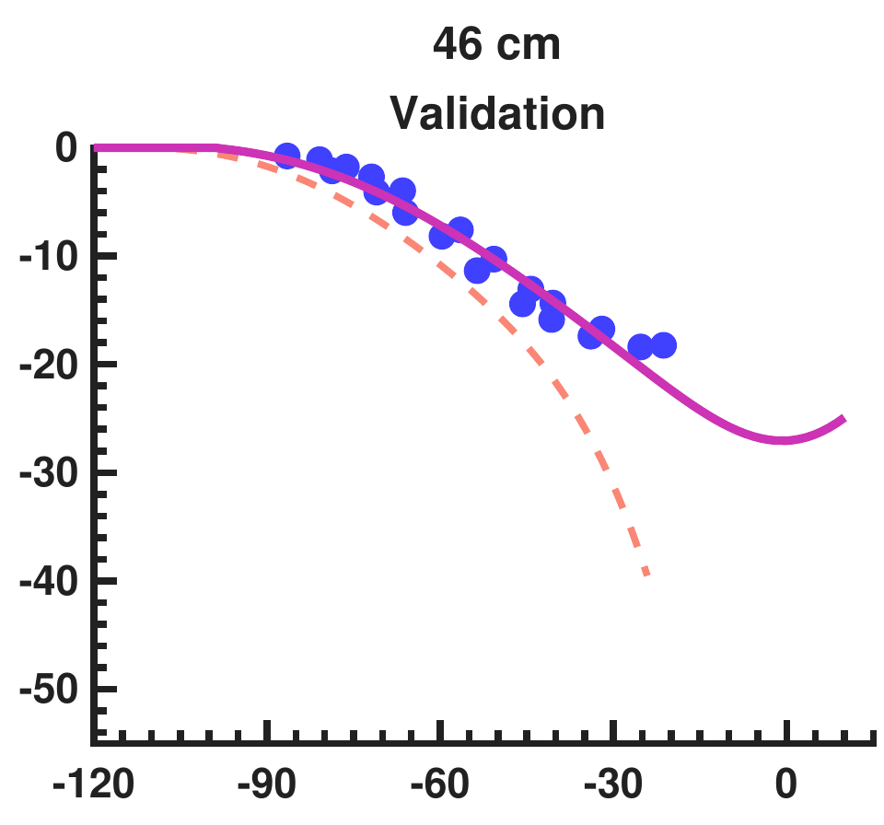
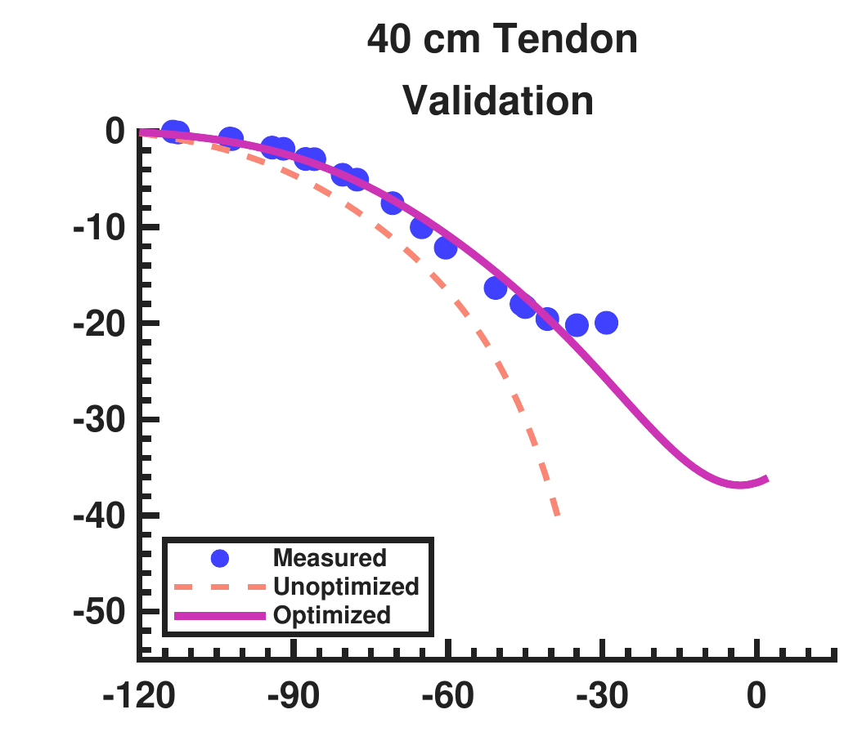
BACKUP · ADOPTED FOLD
The held-out flexor traces show the corrected torque trend
Torque, N m
(C)
(D)
Knee angle, deg
Held-out mean RMSE: 7.588 to 1.490 N m
Dissertation Ch. 4 · Current knee-torque manuscript, §§3–4
27
Notes:
Panels C and D are the held-out nominal 46 cm and 40 cm-tendon tests, corresponding to actual 45.7 and 40.6 cm. Separate crops retain the full traces and shared legend; native labels supply panel letters and axes. The full model shares effective stiffness across both knee configurations. Validation mean RMSE is 1.490 N m.
Source: Dissertation Ch. 4 · Current knee-torque manuscript, §§3–4
Figure provenance:
D:\GitHub\Bipedal_Robot\Documentation\Reports and Papers\Dissertation\Figures\30-torque\FlxPin_optimized_publication.pdf
D:\GitHub\Bipedal_Robot\Documentation\Reports and Papers\Dissertation\Figures\30-torque\FlxPin_optimized_publication.pdf

Slide 28
BACKUP · IDENTIFICATION SCOPE
The adopted identification reserves tests in each configuration
Configuration | Training | Held out | Not used
Pinned flexor | 2 | 2 | 1
Pinned extensor | 3 | 3 | 3
Shared effective stiffness pair: χ₁ = 39.98, χ₂ = 14.73 kN/m
Dissertation Ch. 4 · Current knee-torque manuscript, §§3–4
28
Notes:
Use the exact adopted-fold test split. Flexor training is 48.5 and 41.0 cm; validation is 45.7 and 40.6 cm-tendon; 47 cm was not used. Extensor training is 43.6, 43.2-tendon, and 45.7 cm; validation is 40.0, 40.0-tendon, and 46.5 cm. The early shifted-bracket tests were excluded. Identification uses gamultiobj; route redesign uses surrogateopt and patternsearch. χ1/χ2 are effective stiffness terms, not isolated bracket material values.
Source: Dissertation Ch. 4 · Current knee-torque manuscript, §§3–4
Figure provenance:

Slide 29
BACKUP · RECORDED ACTUATOR DIMENSIONS
Physical dimensions differ from prediction settings
Actuator | Resting length, mm | Tendon length, mm
Flexor 1 | 561 | 28
Flexor 2 | 560 | 30
Extensor 1 | 828 | 92
Extensor 2 | 826 | 85
Prediction inputs: flexor 561.49 / 5.00 mm; extensor 827.74 / ≈92.49 mm
Torque manuscript, Physical Tests · Dissertation Appendix C dimensions
29
Notes:
The rows are physical measurements, in resting/tendon order. Flexor 1 is 561/28 mm, flexor 2 560/30 mm, extensor 1 828/92 mm, and extensor 2 826/85 mm. Prediction inputs instead use shared flexor resting length 561.49 mm and an effective 5.00 mm tendon parameter after fitting adjustment, and extensor resting length 827.74 mm with about 92.49 mm tendon. The nominal 562 mm plot label remains a nominal prediction label.
Source: Torque manuscript, Physical Tests · Dissertation Appendix C dimensions
Figure provenance:

Slide 30
BACKUP · STIMULUS CONTROLS
Stimulation duration changes the deletion interpretation
Protocol | RG shift, cycles | Motor shift, cycles
RG, two periods | 0.211 | 0.211
PF, two periods | 0.000 | 0.000
MN, two periods | 0.000 | 0.000
PF, one second | 0.000 | 0.208
stimulus_results_all.csv · Current Appendix D layer-stimulus protocols
30
Notes:
All values are from the saved table. Two-period RG stimulus: +50 nA for 3.876 s, +0.210526 cycle RG and MN shift. PF same current/duration: zero residual phase at both. MN inhibition: −500 nA for 3.876 s, zero residual. The one-second PF control gives +0.208462 motor shift with zero RG shift. Thus motor phase shift alone does not establish an RG reset. The smaller-current sweep has no observable complete-burst deletion, although brief active-time losses appear in some rows.
Source: stimulus_results_all.csv · Current Appendix D layer-stimulus protocols
Figure provenance:

Slide 31
BACKUP · MATCHED COMPARISON
AH001 separation control changes a matched diagnostic
15–40 s measure | Control off | Control on
Reversed ankle ordering | 67% | 0%
Minimum separation | −38.3 mm | 142.4 mm
Right TFL mean activation | 22.3% | 81.8%
Vertical assistance | 80% BW | 80% BW
Sampled opposite-leg penetration | 2.700 mm | 0 mm
AH001_20261028/PLACEMENT_RECOMMENDATION.md · asset_provenance.json
31
Notes:
Both runs use matching geometry, support, initial pose, and reference tensions. The control bundle adds 160 N/m separation feedback capped at 20 N, plus a 5% to 6% floor on currently abducting routes. The interval is 15–40 s. Zero reversed ordering and zero sampled mesh penetration are separate checks. Toe-out remains about 25–28 degrees, and post-ramp knee motion is small. Exact-fast and reference saved arrays reproduce bit for bit in fresh 40 s runs. This is numerical replay, not robustness or hardware validity.
Source: AH001_20261028/PLACEMENT_RECOMMENDATION.md · asset_provenance.json
Figure provenance:

Slide 32
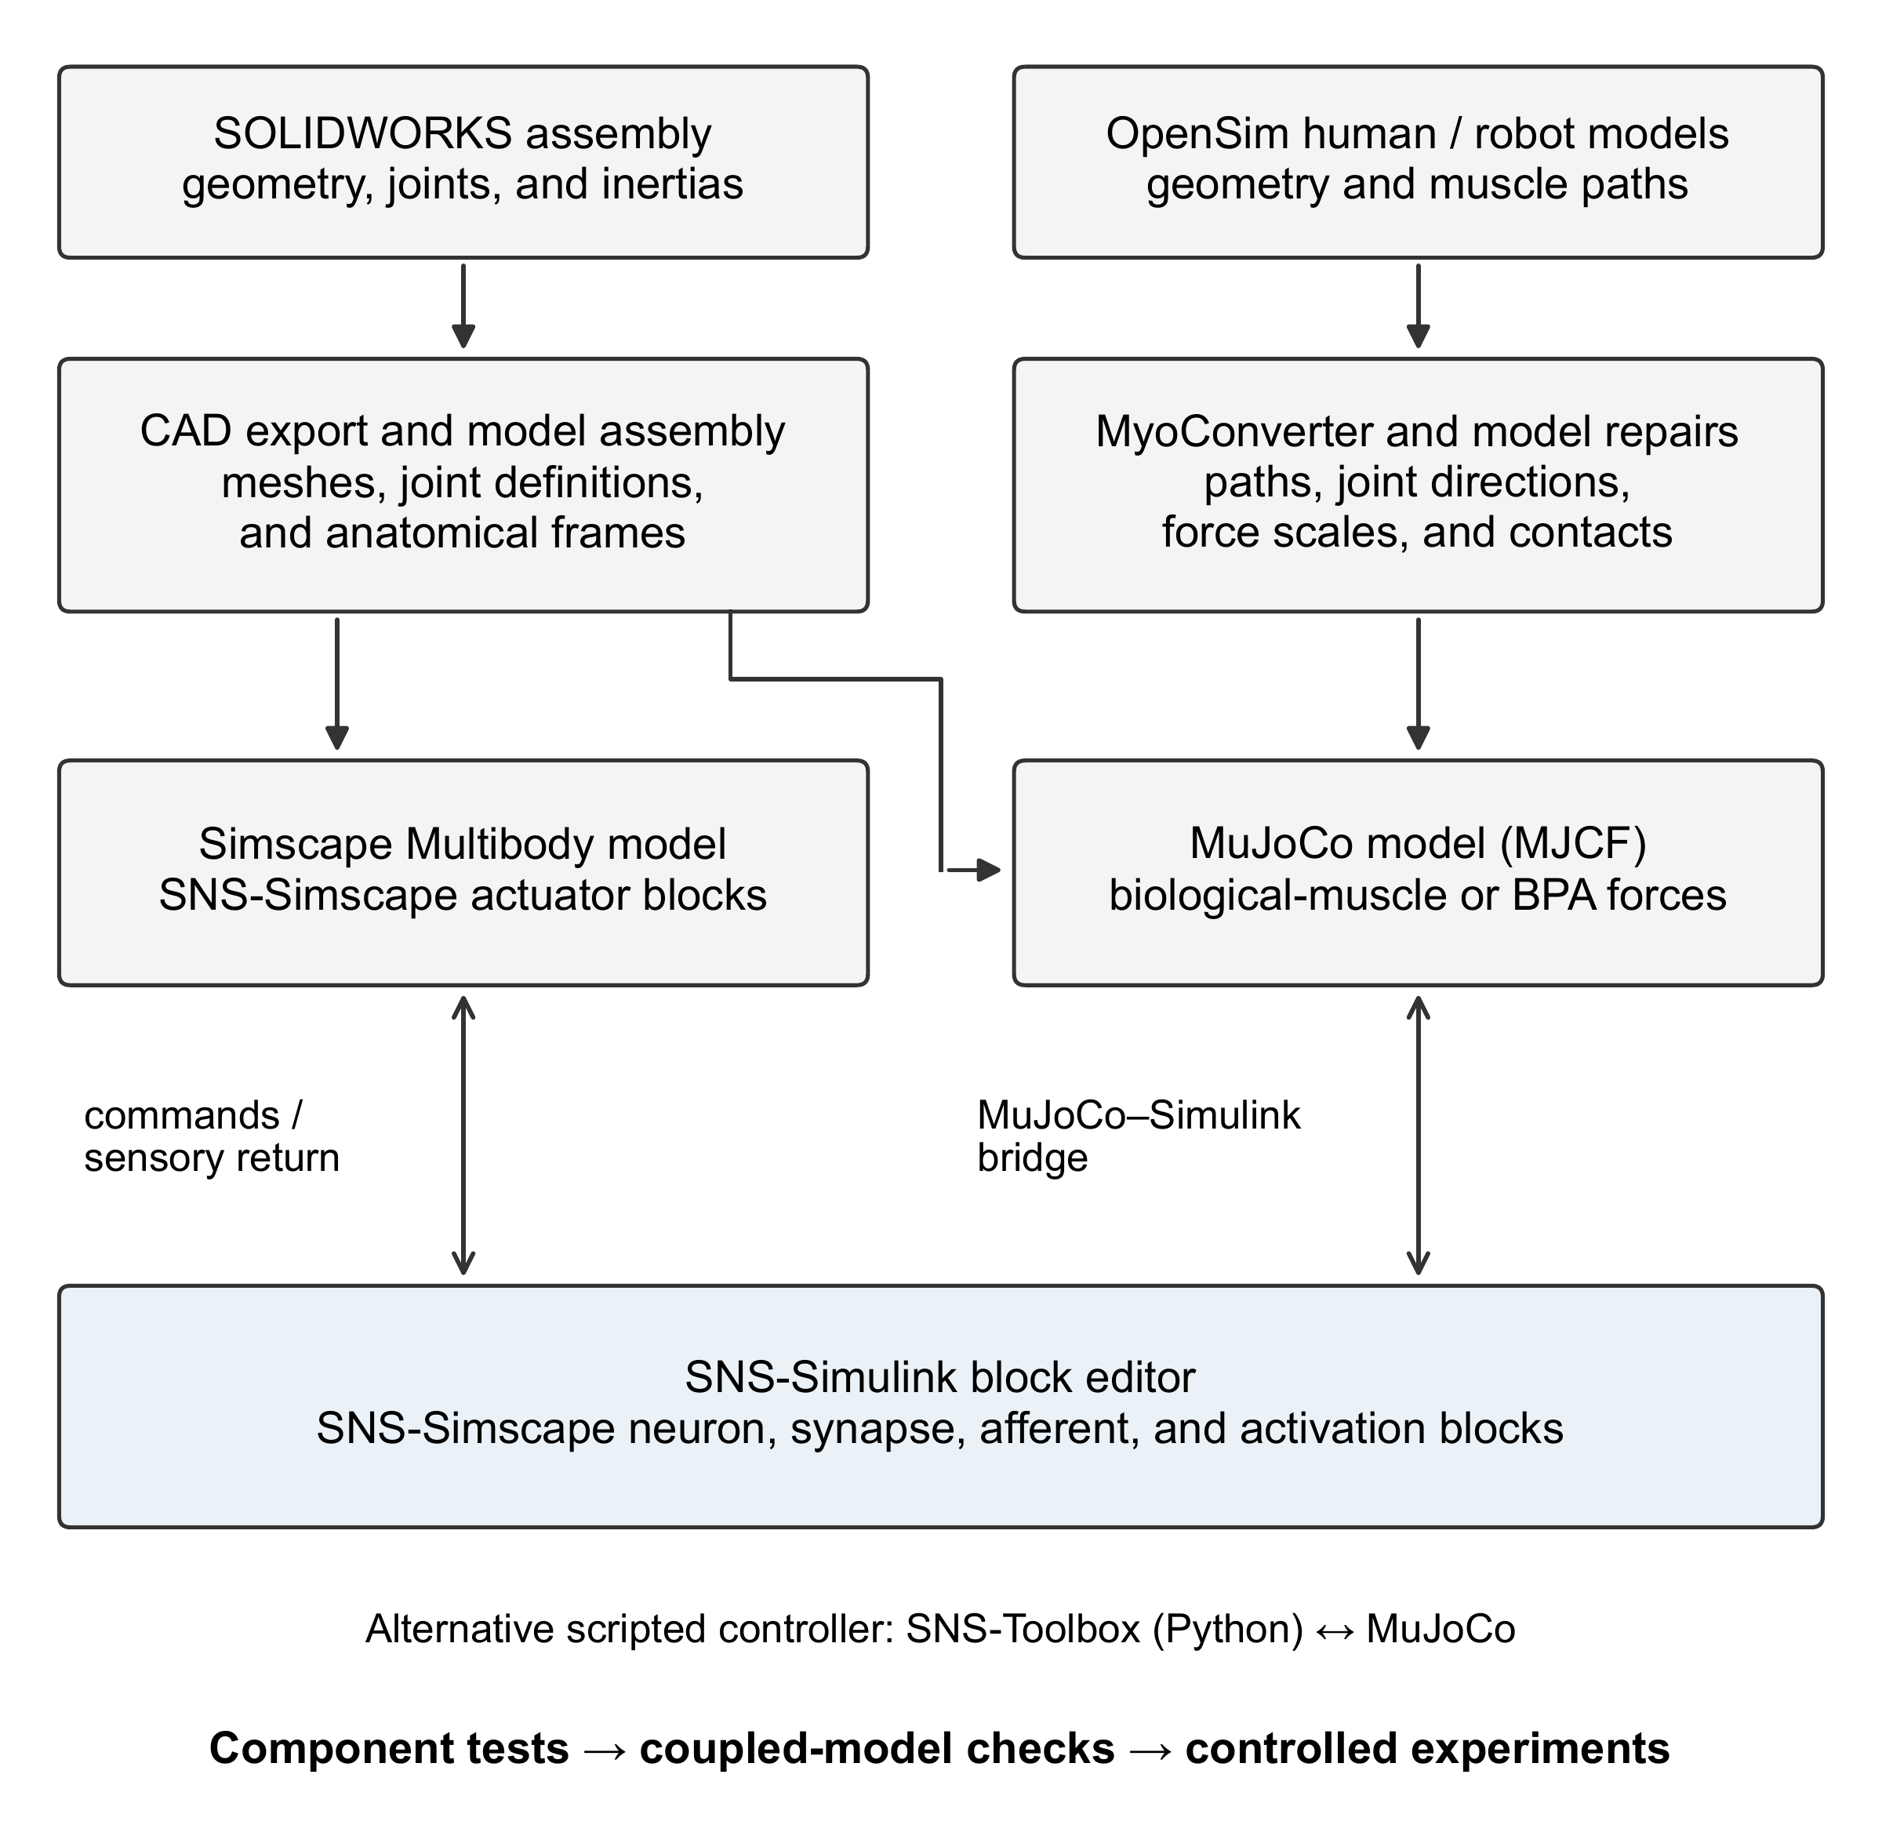
BACKUP · SOFTWARE INTERFACES
The model workflow supports distinct mechanical implementations
Command exchange, circuit agreement, and motion each require their own check
Dissertation Ch. 6, Model construction and neural-controller interfaces
32
Notes:
The source schematic separates CAD/Simscape imports from OpenSim/MyoConverter/MuJoCo conversion and repairs. Neural control uses graphical SNS blocks or scripted SNS-Toolbox. The MathWorks bridge provides a command/sensor interface, not evidence that every circuit transfers dynamically. My contribution is the neural/actuator coupling, graphical implementations, and verification procedures, building on existing engines and formulations.
Source: Dissertation Ch. 6, Model construction and neural-controller interfaces
Figure provenance:
D:\GitHub\Bipedal_Robot\Documentation\Reports and Papers\Dissertation\Figures\60-sns\simulation_workflow.pdf

Slide 33

BACKUP · PUBLISHED FORCE COMPARISON
Reported force comparisons favor the model in the shown cases
Measured-versus-predicted force at the two displayed actuator lengths
Bolen et al. (2026), Actuators 15(5):230 · Dissertation Ch. 3
33
Notes:
The selected 10 mm comparisons are the two upper panels of the published figure, with measured force on x and predicted force on y. The diagonal indicates agreement. Preserve model identities and tested length scopes. This supports the comparison in these reported cases and is not an exhaustive model benchmark. The published coefficients and scientific results remain unchanged.
Source: Bolen et al. (2026), Actuators 15(5):230 · Dissertation Ch. 3
Figure provenance:
D:\Github\Bipedal_Robot\Documentation\Reports and Papers\Dissertation\Defense\deck_builder\deck_assets\figs\Comparison.png

Slide 34
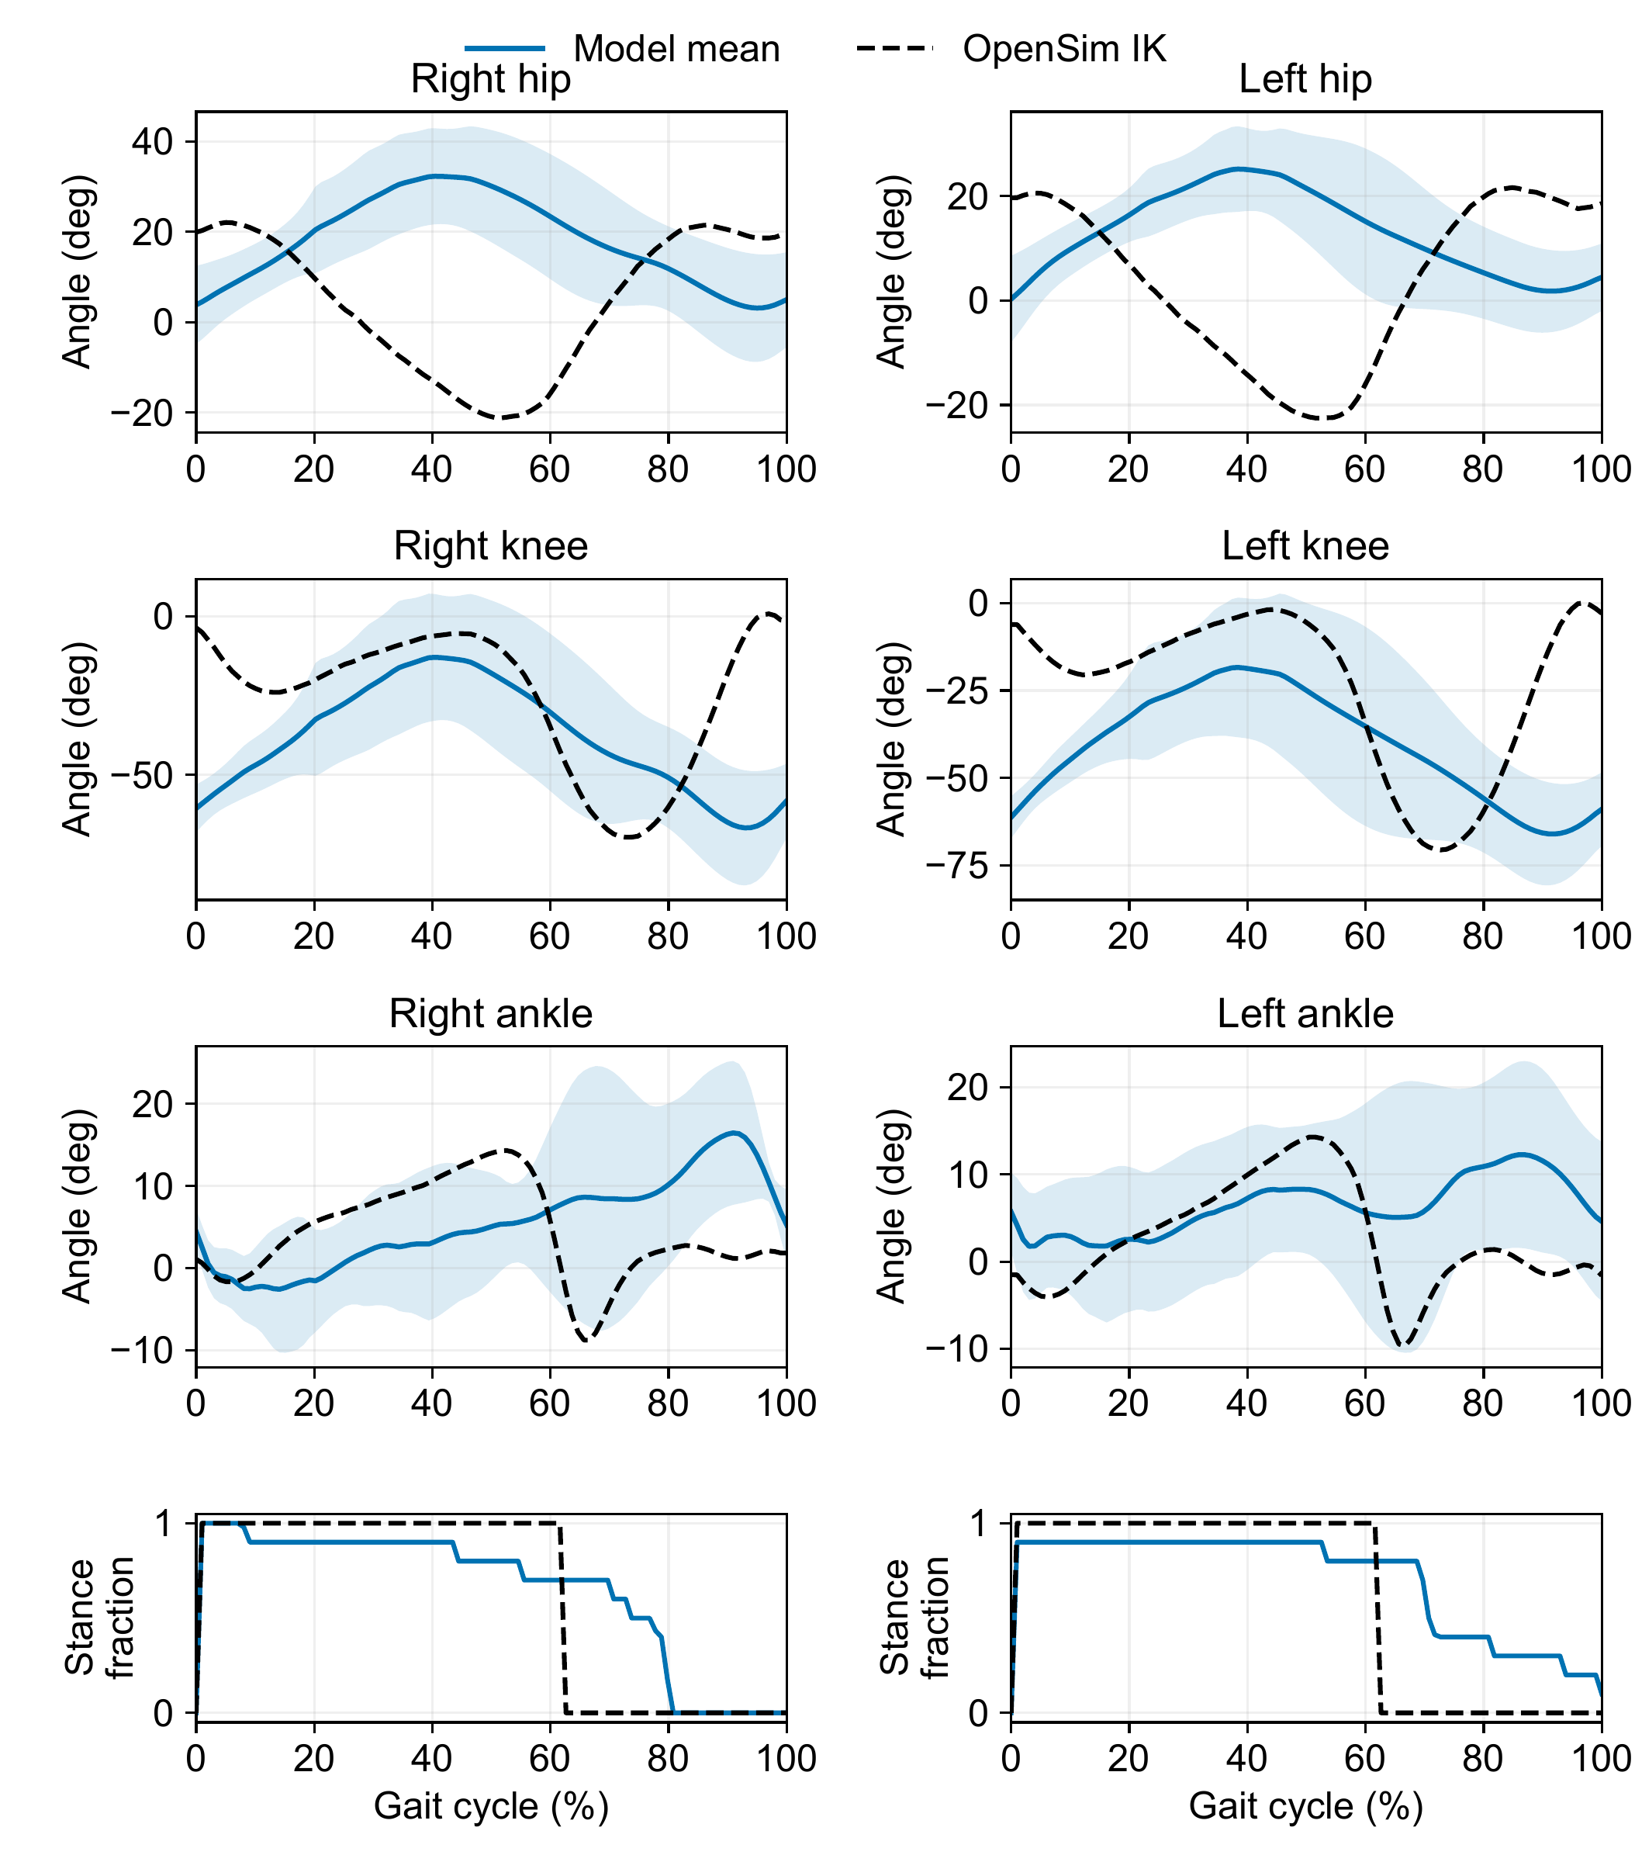
BACKUP · COMPLETE MOVEMENT COMPARISON
The complete IK overlay also exposes contact differences
Model mean and standard deviation · OpenSim IK reference
Dissertation Ch. 6 and Appendix D · Current saved verification records
34
Notes:
This complete source figure includes hip, knee, ankle, and stance/contact comparisons. Each leg is aligned independently to loading onset. The same ten-cycle replay supplies the core-talk crop. No fitted angle offsets, amplitude adjustment, or phase shifts are used. The model and reference stance fractions differ, and separate leg alignment does not establish bilateral phase.
Source: Dissertation Ch. 6 and Appendix D · Current saved verification records
Figure provenance:
D:\GitHub\Bipedal_Robot\Documentation\Reports and Papers\Dissertation\Figures\60-sns\gait2392_ik_overlay.pdf

Slide 35

BACKUP · OPTIONAL ANIMATION
The saved AH001 replay shows supported hybrid motion
Optional 12-second replay · same supported-control diagnostic
AH001_20261028/asset_provenance.json · saved 20–32 s interval
35
Notes:
Optional 12-second replay of the same supported AH001 abductor-control condition. The GIF contains 96 frames over 20–32 s. It illustrates the recorded kinematics and leg separation, not accepted regular stepping. Use slide 23 for support, actuator, and MN-clamp scope, and slide 31 for the matched measures.
Source: AH001_20261028/asset_provenance.json · saved 20–32 s interval
Figure provenance:
D:/GitHub/Bipedal_Robot/Documentation/Reports and Papers/Dissertation/Defense/slideshow/AH001_20261028/ah001_abductor_control.gif

